Slide 1
R – Basic Statistics

Slide 2
Descriptive Statistics
# get means for variables in data frame mydata # excluding missing values sapply(mydata, mean, na.rm=TRUE)
Possible functions used in sapply include mean, sd, var, min, max, median, range, and quantile.

Slide 3
# mean,median,25th and 75th quartiles,min,max
summary(mydata)
# Tukey min,lower-hinge, median,upper-hinge,max
fivenum(x)

Slide 4
About “NA”
R's modeling functions accept an na.action argument that tells the function what to do when it encounters an NA.
Problem with empty “” , and NA

Slide 5
mydata <- c(10,15,20,22,82,54) # mean,median,25th and 75th quartiles,min,max sm <- summary(mydata) print(sm)
Summary provides mean, min.max data

Slide 6
mydata <- c(10,15,20,22,82,54)
sm <- summary(mydata)
print(sm)
print(is.na(mydata)) # returns TRUE of x is missing
y <- c(1,2,3,NA)
print(is.na(y)) # returns a vector (F F F T)

Slide 7
data <- read.csv("C:\\Users\\radhapavan\\Desktop\\R Tutorial\\input.csv") print(data) sm <- summary(data$salary) print(sm)

Slide 8
print(mean(data$salary)) # returns NA print(mean(data$salary, na.rm=TRUE)) # returns

Slide 9
Missing Records-Rows
# list rows of data that have missing values
print(data[!complete.cases(data),])

Slide 10
na.omit
# create new dataset without missing data dtx <- na.omit(data) print(dtx)

Slide 11
Mean
It is calculated by taking the
sum of the values and dividing with the number of values in a data series.
mean(x, trim = 0, na.rm = FALSE, ...)
Trim to exclude some observations.
result.mean <- mean(x,trim = 0.3)
When trim = 0.3, 3 values from each end will be dropped from the calculations to find mean.
na.rm = TRUE

Slide 12
# Create a vector.
x <- c(12,7,3,4.2,18,2,54,-21,8,-5)
# Find Mean.
result.mean <- mean(x)
print(result.mean)
# Find Mean.
result.mean <- mean(x,trim = 0.3)
print(result.mean)
# Find mean dropping NA values.
result.mean <- mean(x,trim = 0.3, na.rm = TRUE)
print(result.mean)

Slide 13
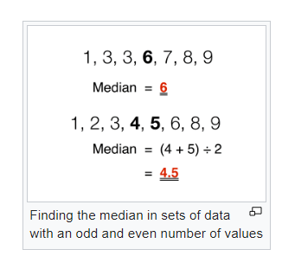
Median
Median
The middle most value in a data series is called the median.
The median()function is used in R to calculate this value.
# Create the vector. x <- c(12,7,3,4.2,18,2,54,-21,8,-5) # Find the median. median.result <- median(x) print(median.result)
First Order – sort, then middle

Slide 14
Mode
The mode is the value that has highest number of occurrences in a set of data.
Unike mean and median, mode can have both numeric and character data.
R does not have a standard in-built function to calculate mode.
Unlike mean and median, the concept of mode also makes sense for "nominal data" (i.e., not consisting of numerical values in the case of mean, or even of ordered values in the case of median)

Slide 15
Getmode() – user defined
# Create the function.
getmode <- function(v) {
uniqv <- unique(v)
uniqv[which.max(tabulate(match(v, uniqv)))]
}
# Create the vector with numbers. v <- c(2,1,2,3,1,2,3,4,1,5,5,3,2,3) # Calculate the mode using the user function. result <- getmode(v) print(result)

Slide 16
Central tendency Theorem
Central Limit Theorem – CLT
The central limit theorem (CLT) is a statistical theory that states that given a sufficiently large sample size from a population with a finite level of variance, the mean of all samples from the same population will be approximately equal to the mean of the population. Furthermore, all of the samples will follow an approximate normal distribution pattern, with all variances being approximately equal to the variance of the population divided by each sample's size.

Slide 17
Variance() , STANDARD DEVIATION
variance.result = var(x) # calculate variance print (variance.result)
sd.result = sqrt(var(x)) # calculate standard deviation
print (sd.result)

Slide 18
mean
Arithmetic mean
Geometric mean
Harmonic mean

Slide 19
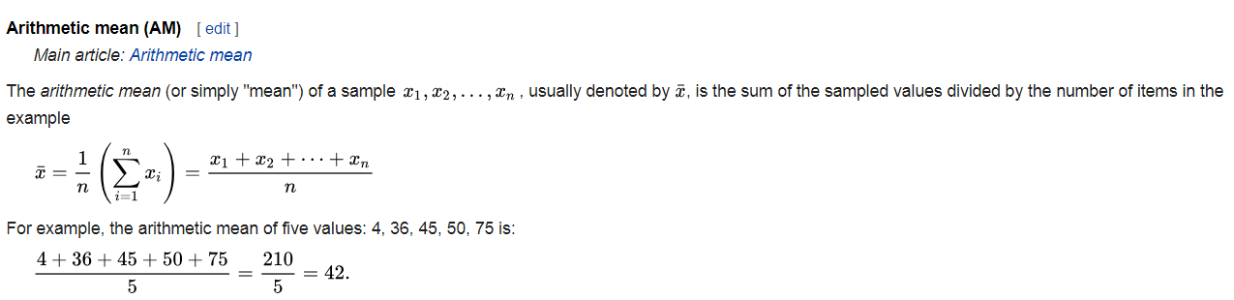
Mean, = Average = X bar

Slide 20
Skewed
An example of a skewed distribution is personal wealth: Few people are very rich, but among those some are extremely rich. However, many are rather poor.

Slide 21
A descriptive statistic (in the count noun sense) is a summary statistic that quantitatively describes or summarizes features of a collection of information,

Slide 22

Variance
Example of samples from two populations with the same mean but different variances. The red population has mean 100 and variance 100 (SD=10) while the blue population has mean 100 and variance 2500 (SD=50).
In probability theory and statistics, variance is the expectation of the squared deviation of a random variable from its mean
Squared Deviation
From Its mean
Sigma / s square

Slide 23

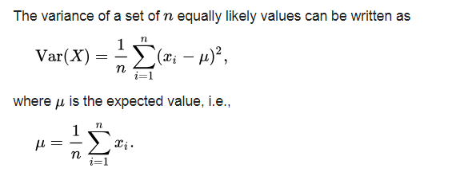
The variance is the square of the standard deviation, the second central moment of a distribution, and the covariance of the random variable with itself

Slide 24
Normal distribution
exponential distribution
Poisson distribution
Binomial distribution
Fair Die – 6 Dice

Slide 25
Histogram
x <- c(8,2,7,1,2,9,8,2,10,9) #Exploratory Data Analysis hist(x)
Distribution

Slide 26
Boxplot
Boxplot(x)
Importance of Box plot

Slide 27
Sample data
Mtcars
airquality
dim(airquality)
#install.packages("psych") library(psych) describe(mtcars)

Slide 28
Save to PDF
print(Sys.time())
#print(strftime(Sys.Date(),'%A: %B %d, %Y (Day %j of %Y)'))
#print(format(Sys.time(), "%a %b %d %X %Y"))
Ft <- format(Sys.time(), "BasicPDF_%a_%b_%d_%Y_%H%M%S")
filename= paste(Ft,".pdf",sep="")
print(filename)
pdf(filename)
x <- c(8,2,7,1,2,9,8,2,10,9)
#Exploratory Data Analysis
hist(x)
boxplot(x)
dev.off()

Slide 29
mtcars
A data frame with 32 observations on 11 (numeric) variables.
[, 1] mpg Miles/(US) gallon
[, 2] cyl Number of cylinders
[, 3] disp Displacement (cu.in.)
[, 4] hp Gross horsepower
[, 5] drat Rear axle ratio
[, 6] wt Weight (1000 lbs)
[, 7] qsec 1/4 mile time
[, 8] vs Engine (0 = V-shaped, 1 = straight)
[, 9] am Transmission (0 = automatic, 1 = manual)
[,10] gear Number of forward gears
[,11] carb Number of carburetors

Slide 30
Plot- hist,boxplot
mtcars
#print(head(mtcars))
#str(mtcars)
print(summary(mtcars$wt))
print(hist(mtcars$wt))
print(boxplot(mtcars$wt))
dev.off()

Slide 31
airquality - it has missing values
airquality
print(head(airquality))
#Summary Statistics
print(dim(airquality))

